Slide 1
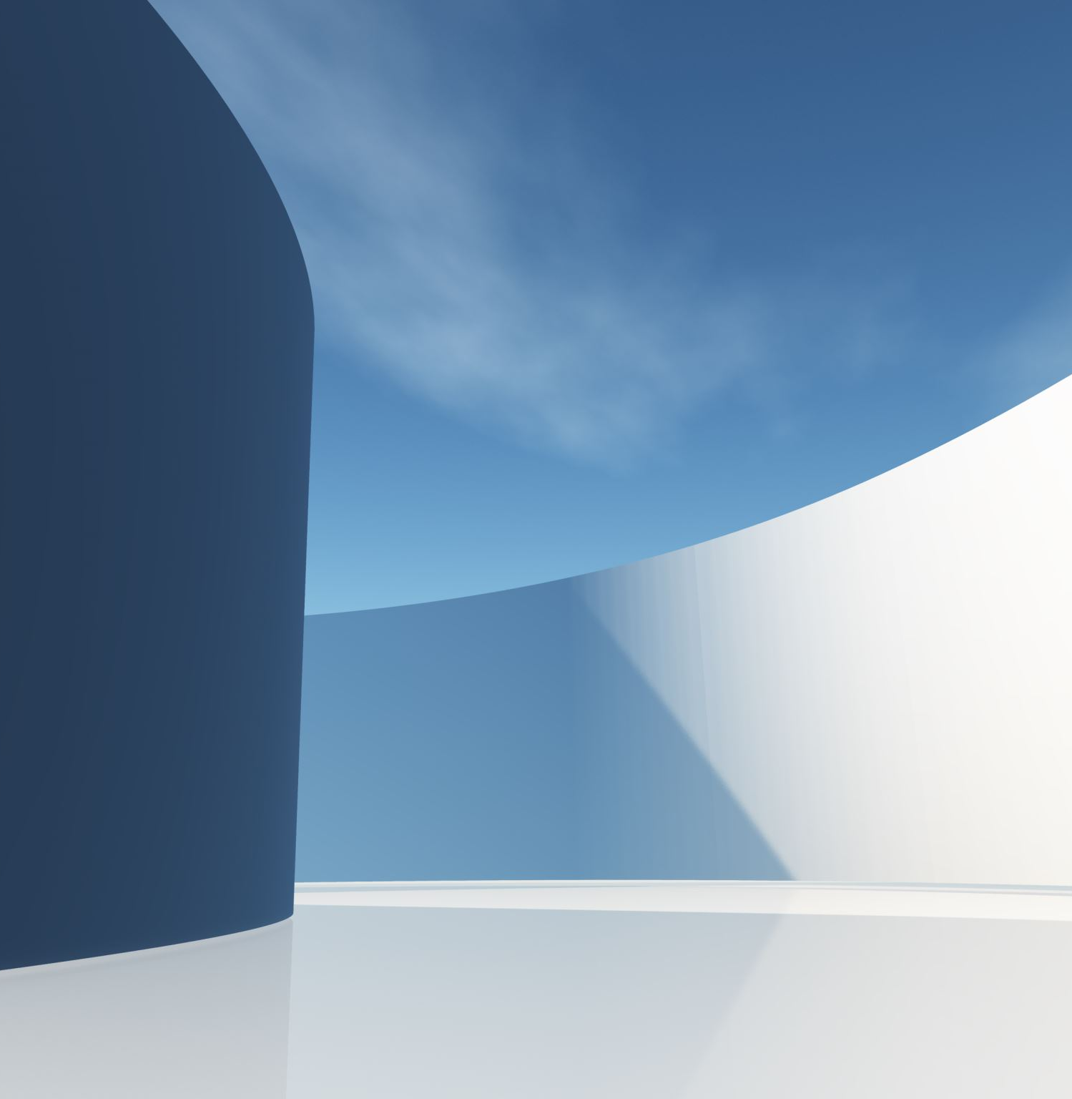

GLOCER24 CAMPAIGN
BY: ISABELLA FRENCH

Slide 2
Research
Glocer’s Key Themes: the future of education & research
A place for others to collaborate & share their knowledge & learn from others
Target Audience: researchers, educators, scientists, and others in the education field
Notes:
For this campaign I researched GLOCER 24 and looked into everything that they have done over the years of being a conference. GLOCER’s key themes focus on the future of education and research. The conference is a way for those in that field to collaborate and share their knowledge and also, learn more from other presenters about their field. Since this is a more professional event, the most engagement would come from Instagram and LinkedIn with their target audience being research professionals, educators, and others in the education field. Instagram would reach the younger demographic of the target audience but will also receive the highest amount engagement in my opinion for this specific campaign.

Slide 3
Research
Best practices for social media campaigns in hospitality:
-Use engaging and interactive functions on posts and stories to ensure there is a reach from the audience
-Be consistent with your content
Notes:
When researching what are the best practices for social media campaigns in the hospitality field, a bunch of practices came up, but a few stood out to me. Using things like hashtags and interactive scrolls and polls is what can make this campaign much better. This can ensure that your audience is not only seeing your posts and reading the information, but it makes it to where they will remember the post better. Being consistent is also another very important because keeping the posts strategic but not sporadic is helpful with providing the right information, getting feedback when needed, getting to know your audience, etc.

Slide 4
Content Calendar
Week 1: the week before
-Day 1: Instagram Story (Countdown to GLOCER 24! 7 DAYS AWAY) & LinkedIn Post(Excited to announce…)
-Day 2: Instagram & LinkedIn Post (Meet the Conference Chairs)
-Day 4: LinkedIn post (Blast to the past! Old photos for past attendees to share)
-Day 6: Instagram Story (Post of the schedule the day before)
Week 2: the week after
-Day 1: Instagram and LinkedIn (THANK YOU FOR ATTENDING!)
-Day 3: Instagram Story (What was your favorite memory at a GLOCER conference?) (text input box)
-Day 5: Instagram Post (What’s to come with GLOCER)
Notes:
My calendar starts on the week before the event and goes to the week after. This is to show how you can keep your audiences. Attention even after the event. Posting things like a countdown or a meet the chairs the week before gets them excited for what is to come. But with a thank you post and and whats your favorite memory instagram story after the conference, this gets you not only the feedback of what to continue doing and what to not continue doing but also has the attendees remembering the educational time at the conference and it might encourage them to share to us for the campaign but also to others to attend in the future. For the content, I plan on using the hashtags #LeadYourMind and #EducateYourself as my words of affirmation and encouragement. I will also include ones like #GLOCER24 and #USF to make sure it finds the right audiences.

Slide 5
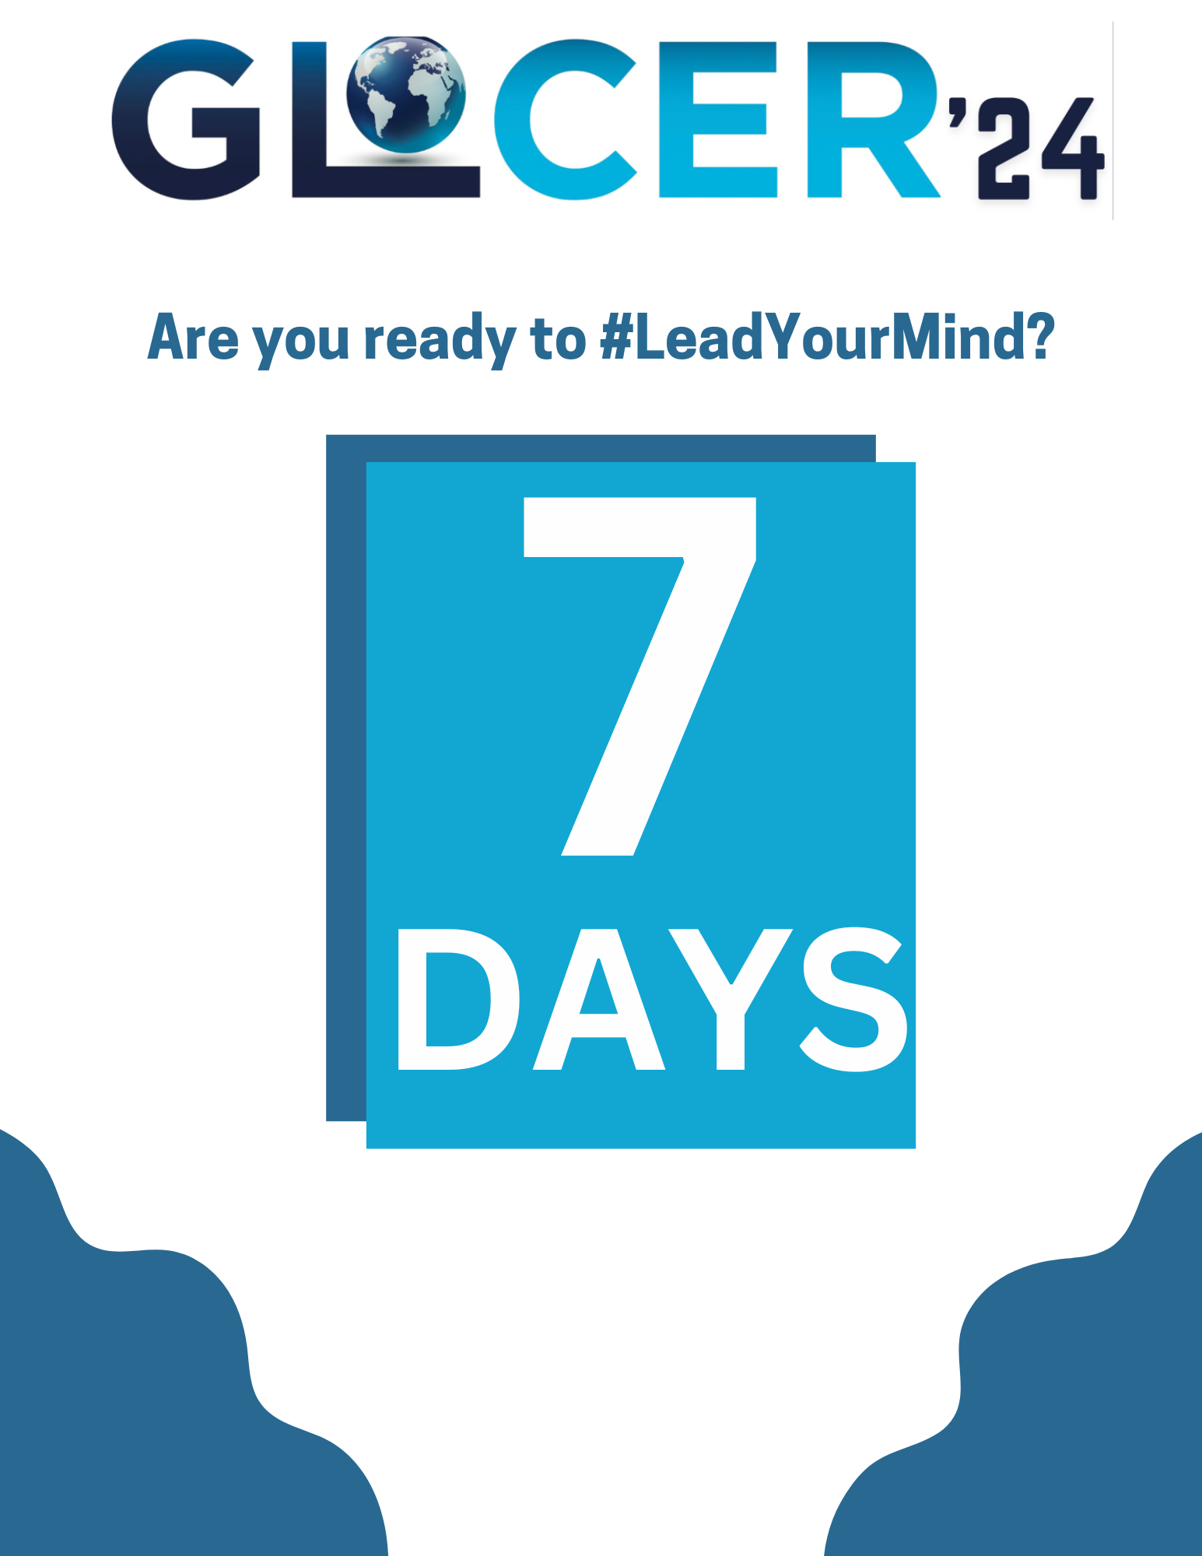
Content Creation
Day 1 of the content calendar
-Instagram Story Countdown
-Will be posted everyday
Notes:
The first post I chose to create was Instagram story for the countdown to the conference. It will include the countdown as well as a swipe uplink to GLOCER’s website in the case the viewers want to learn more about the conference on their own & also to get information on where the conference is if someone is a first-time attendee. I would plan to post this on the story of the account everyday to keep the attendees and followers updated about when the conference is happening so there is no confusion.

Slide 6
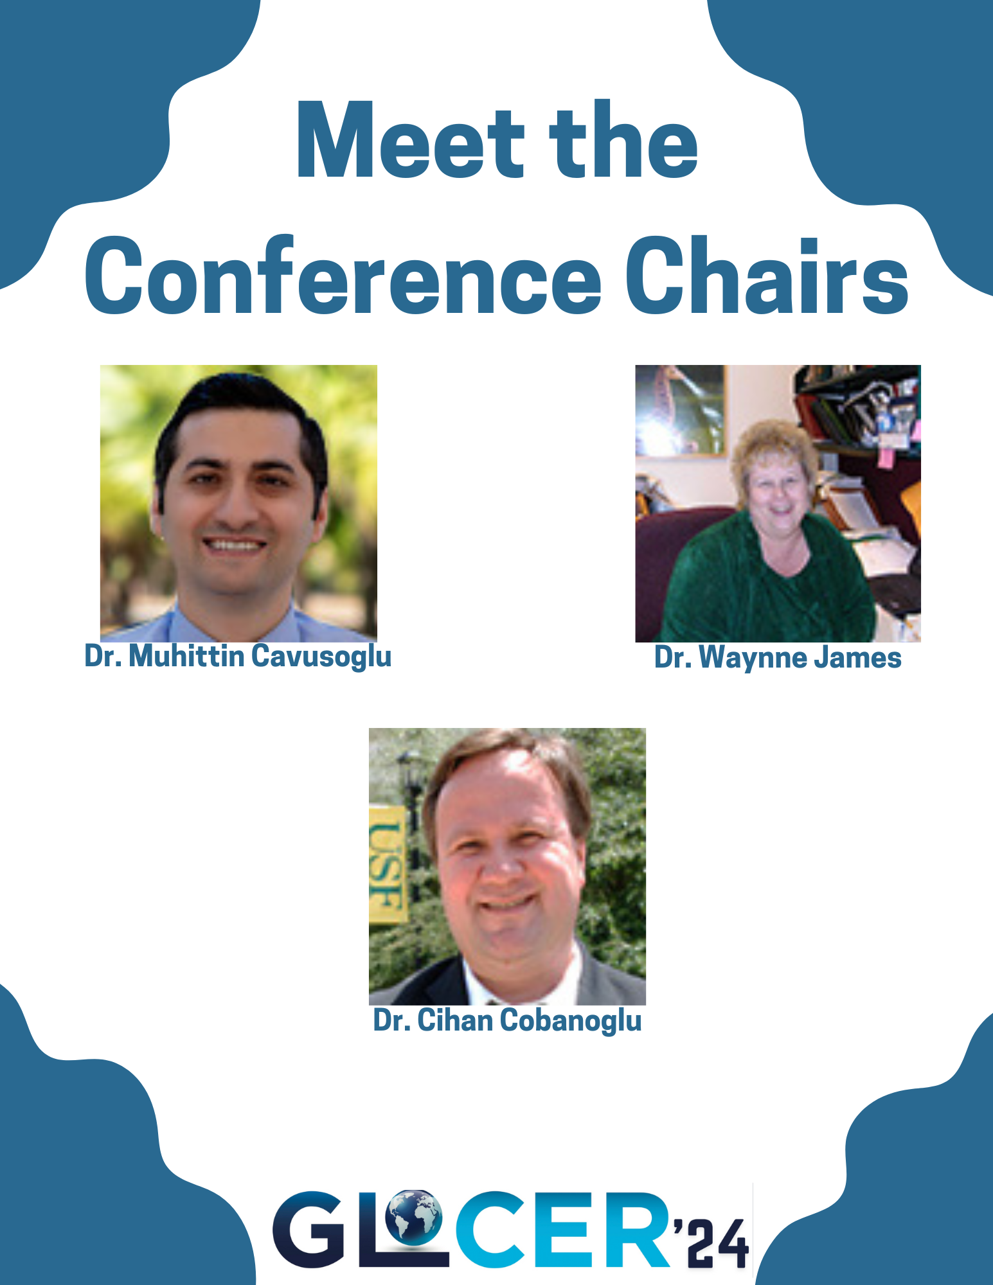
Content Creation
Day 2 Instagram & LinkedInPost
Caption: Meet the Conference Chairs! Without them GLOCER wouldn’t be what it is today! Come meet them at GLOCER 24 Conference this week! #Glocer24 #LeadYourMind #EducateYourself #GlocerConference2024
Notes:
The second post I chose to do a meet the conference chairs post because many people when attending events, from my experience love to know who is behind all the work. This amazing group of people have worked together for these conferences so why not give them not only the recognition they deserve but also a chance to share to their colleagues that they are apart of something. The caption I chose to put under it is “Meet the Conference Chairs! Without them GLOCER wouldn’t be what it is today! Come meet them at GLOCER 24 Conference this week!” Using these hashtags will make it easier for more people to find similar posts about the conference before or after they have attended. They can also us them to share their photos and experience with their audience.

Slide 7
Implementation
-Plan to post between morning, lunch(12pm), & late afternoon
-Posts will be done mostly on Instagram and LinkedIn
-Click through rate will grow
Notes:
The implementation is hard to imagine when something isn’t actively happening or being done but I took into consideration how my personal engagement is and thought how would someone that was attending the conference go through the social media. When doing the content posting I plan to have scheduled posts for the morning at around 8 am, around lunch (when most people are relaxing mid day and re on their phone), and in the late afternoon for the less important posts but still to continue the consistent posting. The posts will be done mostly on Instagram and LinkedIn, and I would always plan to include the website URL in all posts as a link to click or to swipe up on stories for those who want to learn more about GLOCER. Including the link would increase the click through rate by so much because it would be on everything, and most would click just to find out what it is but there will be the occasional new mind opened to what GLOCER has to offer.

Slide 8
Analysis & Reflection
Metric | Description | Engagement
Likes | Number of likes expected for each post | 50-75 likes per post
Comments | Number of comments expected for each post | 10-20 comments
Shares | Number of people sharing to their social media | 15 minimum shares
Click-through Rate | Percentage of users that could click the links | 5% - 9%
Reach | Number of followers and non-followers who saw your post | 150-200 profile reach
Story Impressions | Number of people viewing the story and interacting with the functions (polls, countdowns, text boxes) | 70-85 people viewing
Notes:
When posting my content, the engagement was not there to show how it would look if posted for the actual conference. The engagement showed maybe 5 views on stories and about 10 people on the reach statistics. So this table is meant to be a what if to if this was posted on the actual social media for the conference. Many of the engagement would come from the past attendees that keep up with the conference from what I assume as well as the occasional new mind as I said before. The click through rate might seem low but that has the opportunity to grow because as the conference gets closer more people would click for their information and to submit papers, etc. Starting small just means you can always go up and that is what I see GLOCER social media campaign doing for the conference. To keep an eye on the effectiveness of the posts and engagement we would utilize Instagram analytics since it is the social media we are using the most. The data it gives you helps with seeing where you need improvement. You can see where your strongest parts are whether its on your stories or on the posts that include videos rather than pictures. This will help for future posts to know what to do to ensure you are getting the highest engagement possible.

